Slide 1

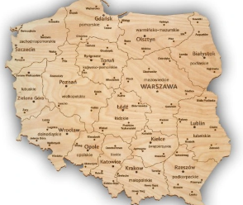
Erasmus+ Ist High School Głowno

Slide 2

Eco steps through Europe – Step 5
Sevilla – Eco Tourism

Slide 3







OUR PARTNERS - logos
New partners:
High school
in Spain
High school
in France
High school in Greece
High school
in Germany
High school
In Italy

Slide 4
Erasmus+ Actions: 1. Group Mobilities 2. Preparatory Visits 3. Teacher Courses

Slide 5
PROJECT GOALS
Learn the principles of responsible and sustainable travel.
Observe the impact of tourism on the environment.
Learn how to protect it.

Slide 6

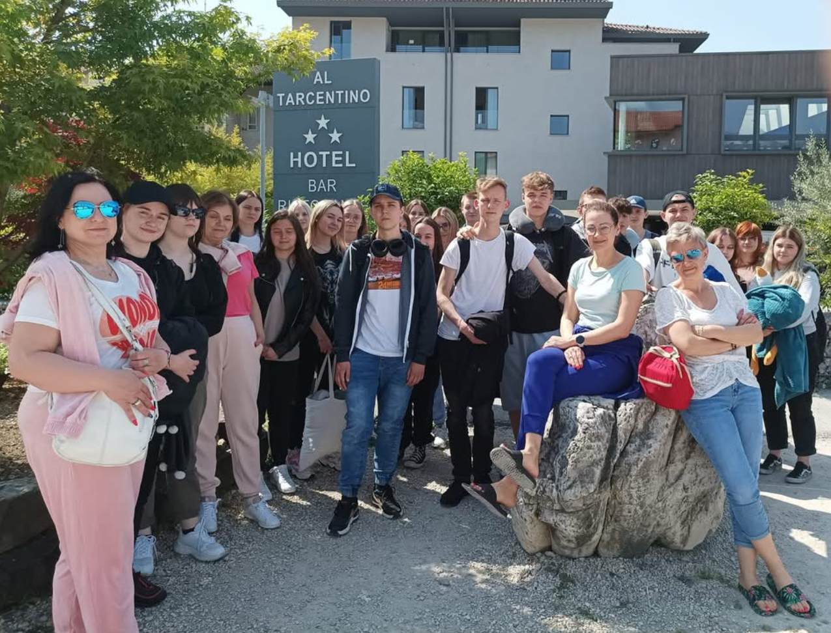
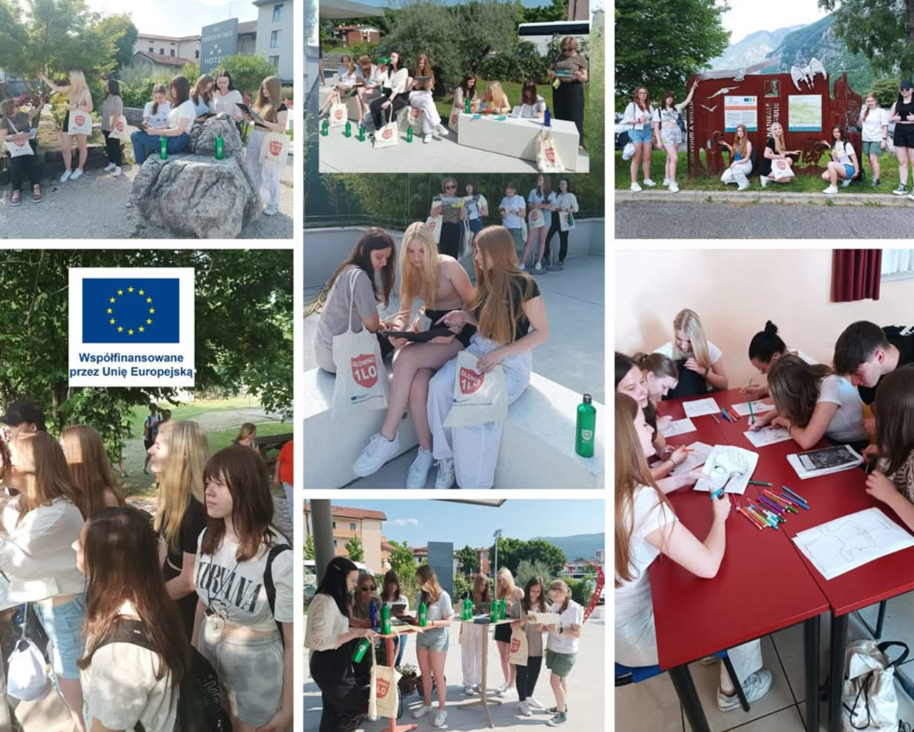
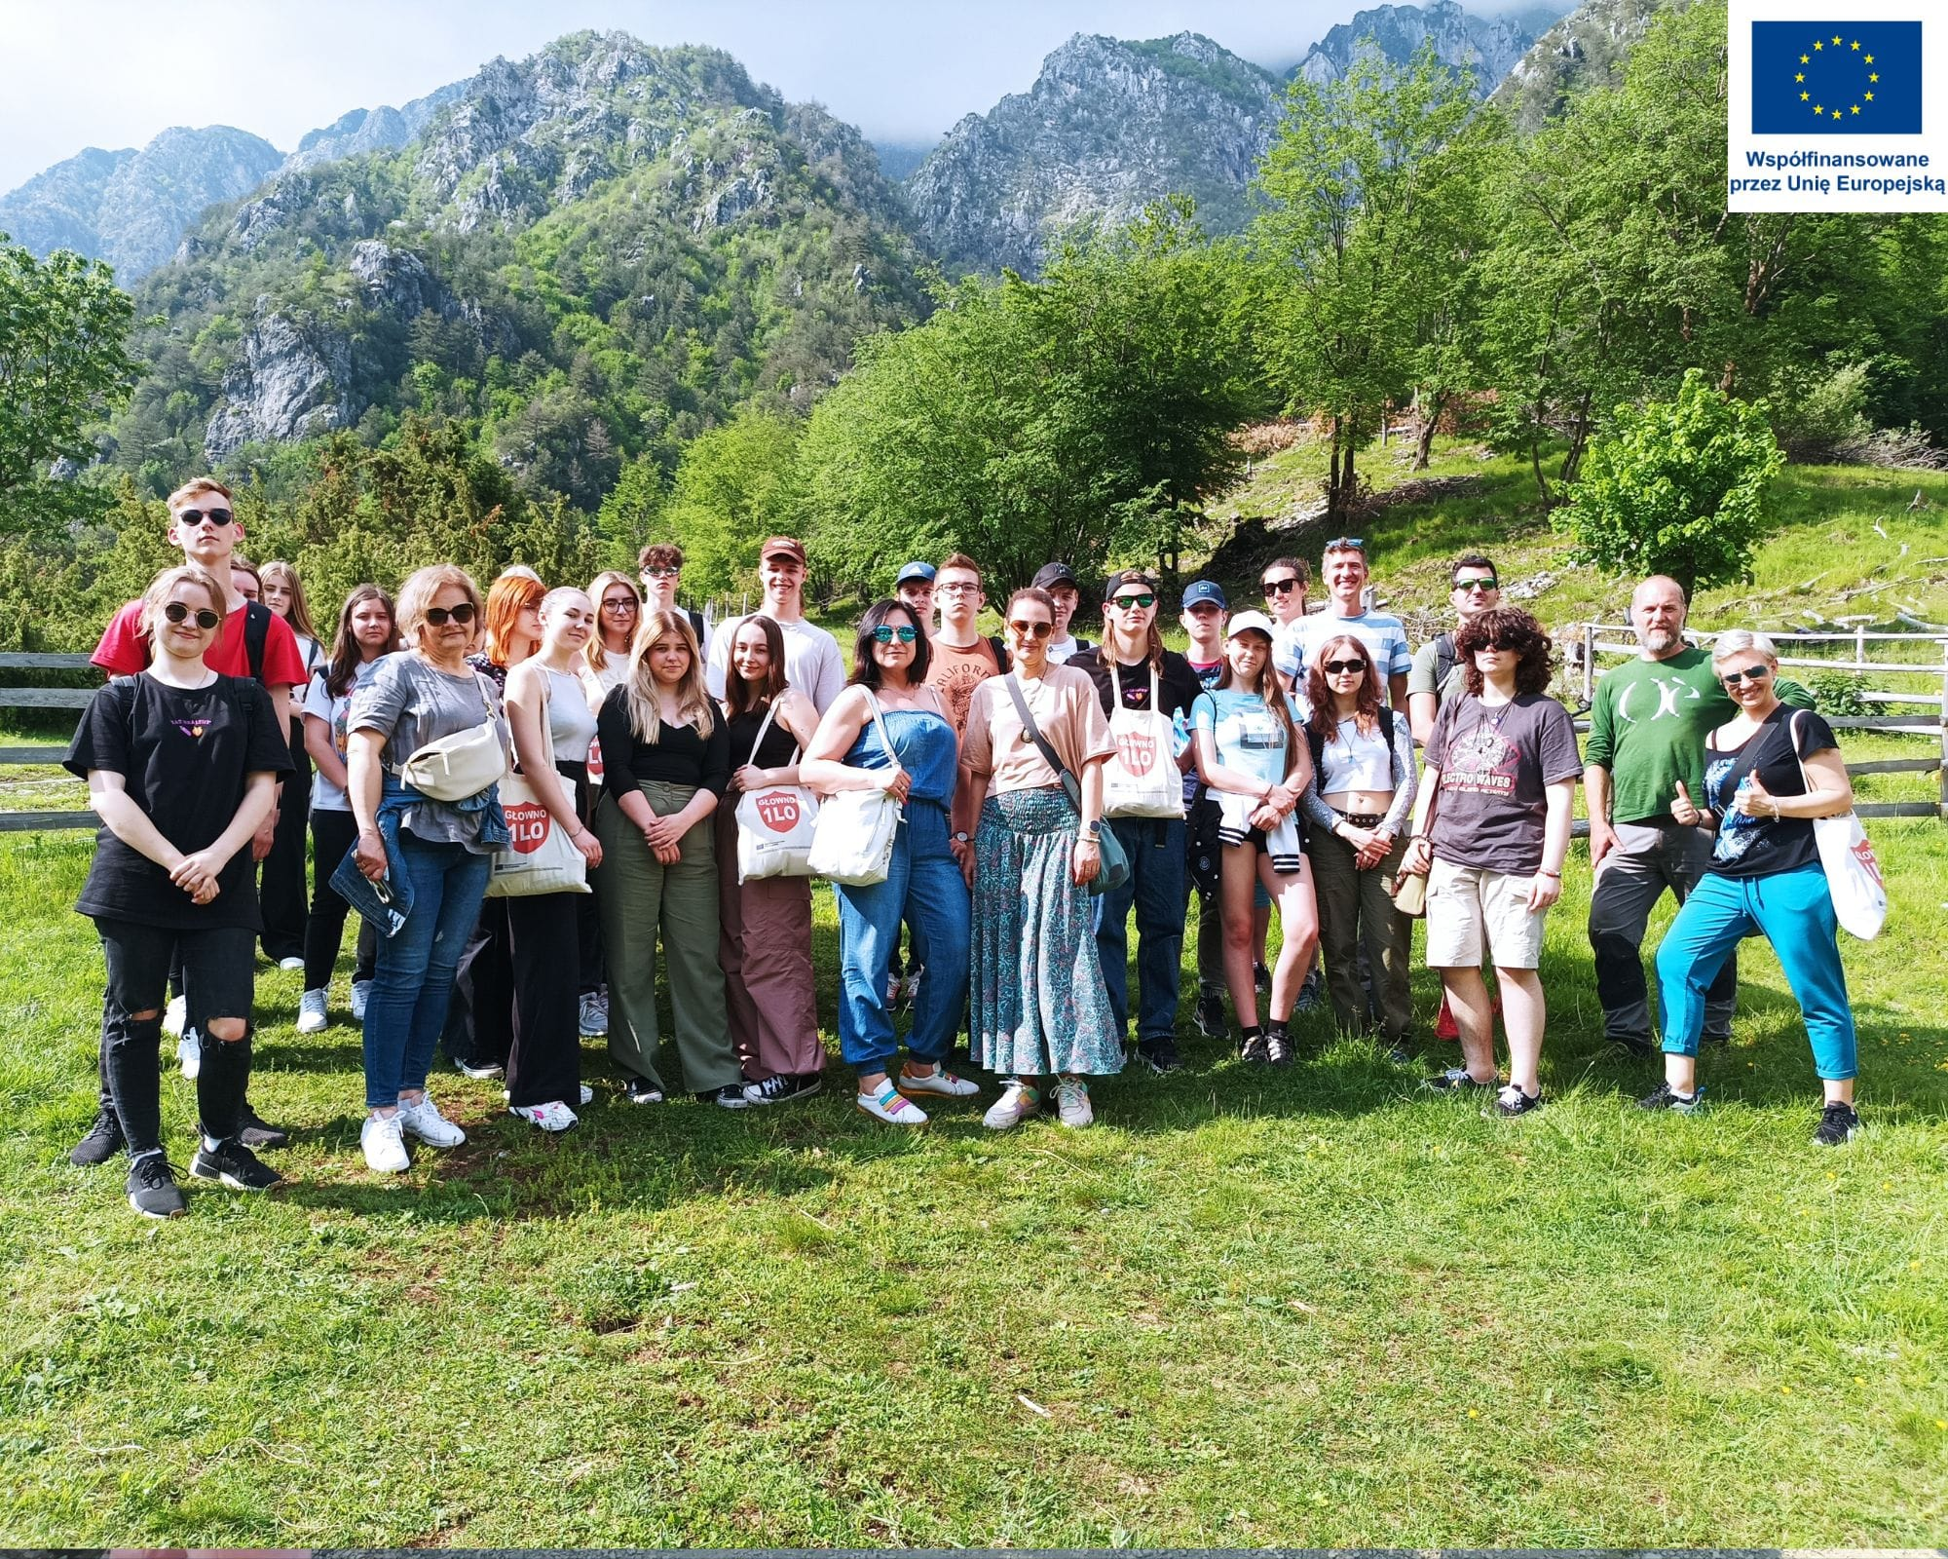
ITALY 2022/23
Friuli
I

Slide 7

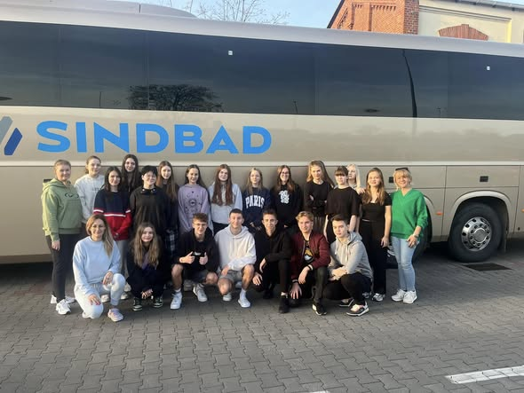
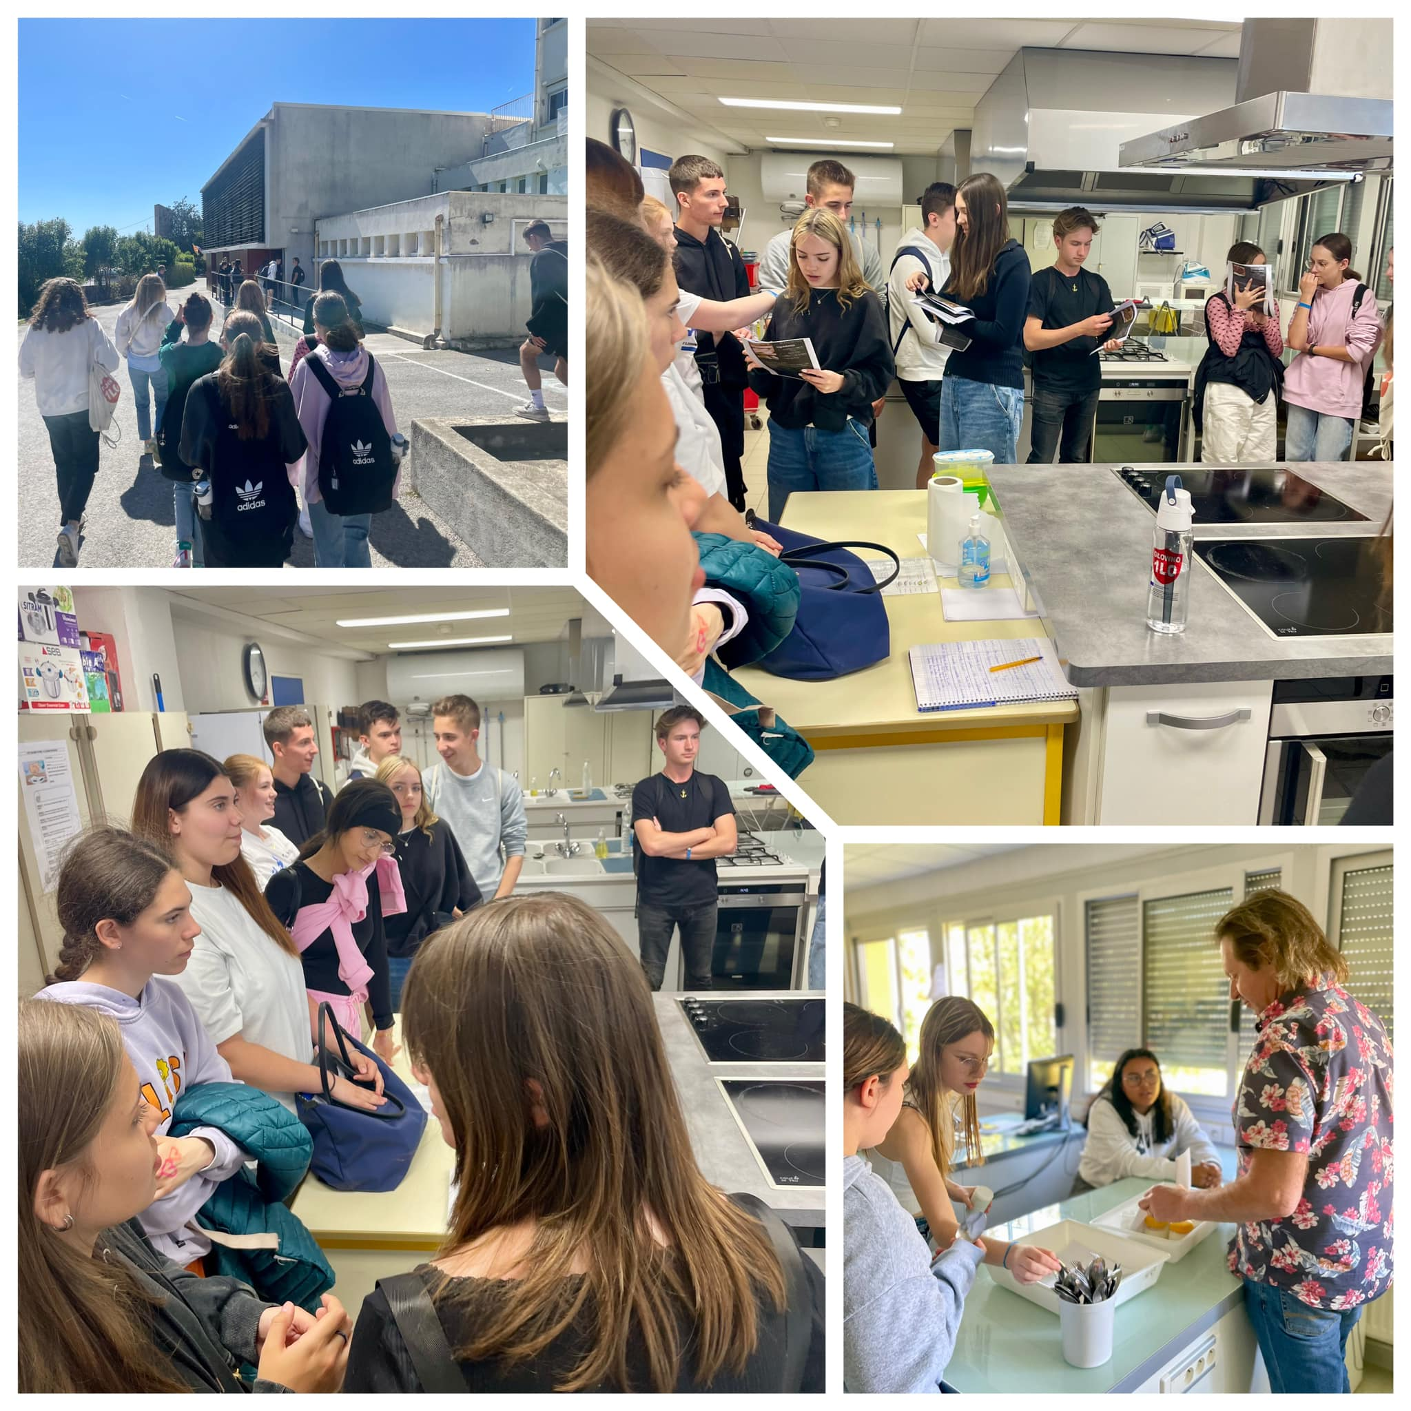
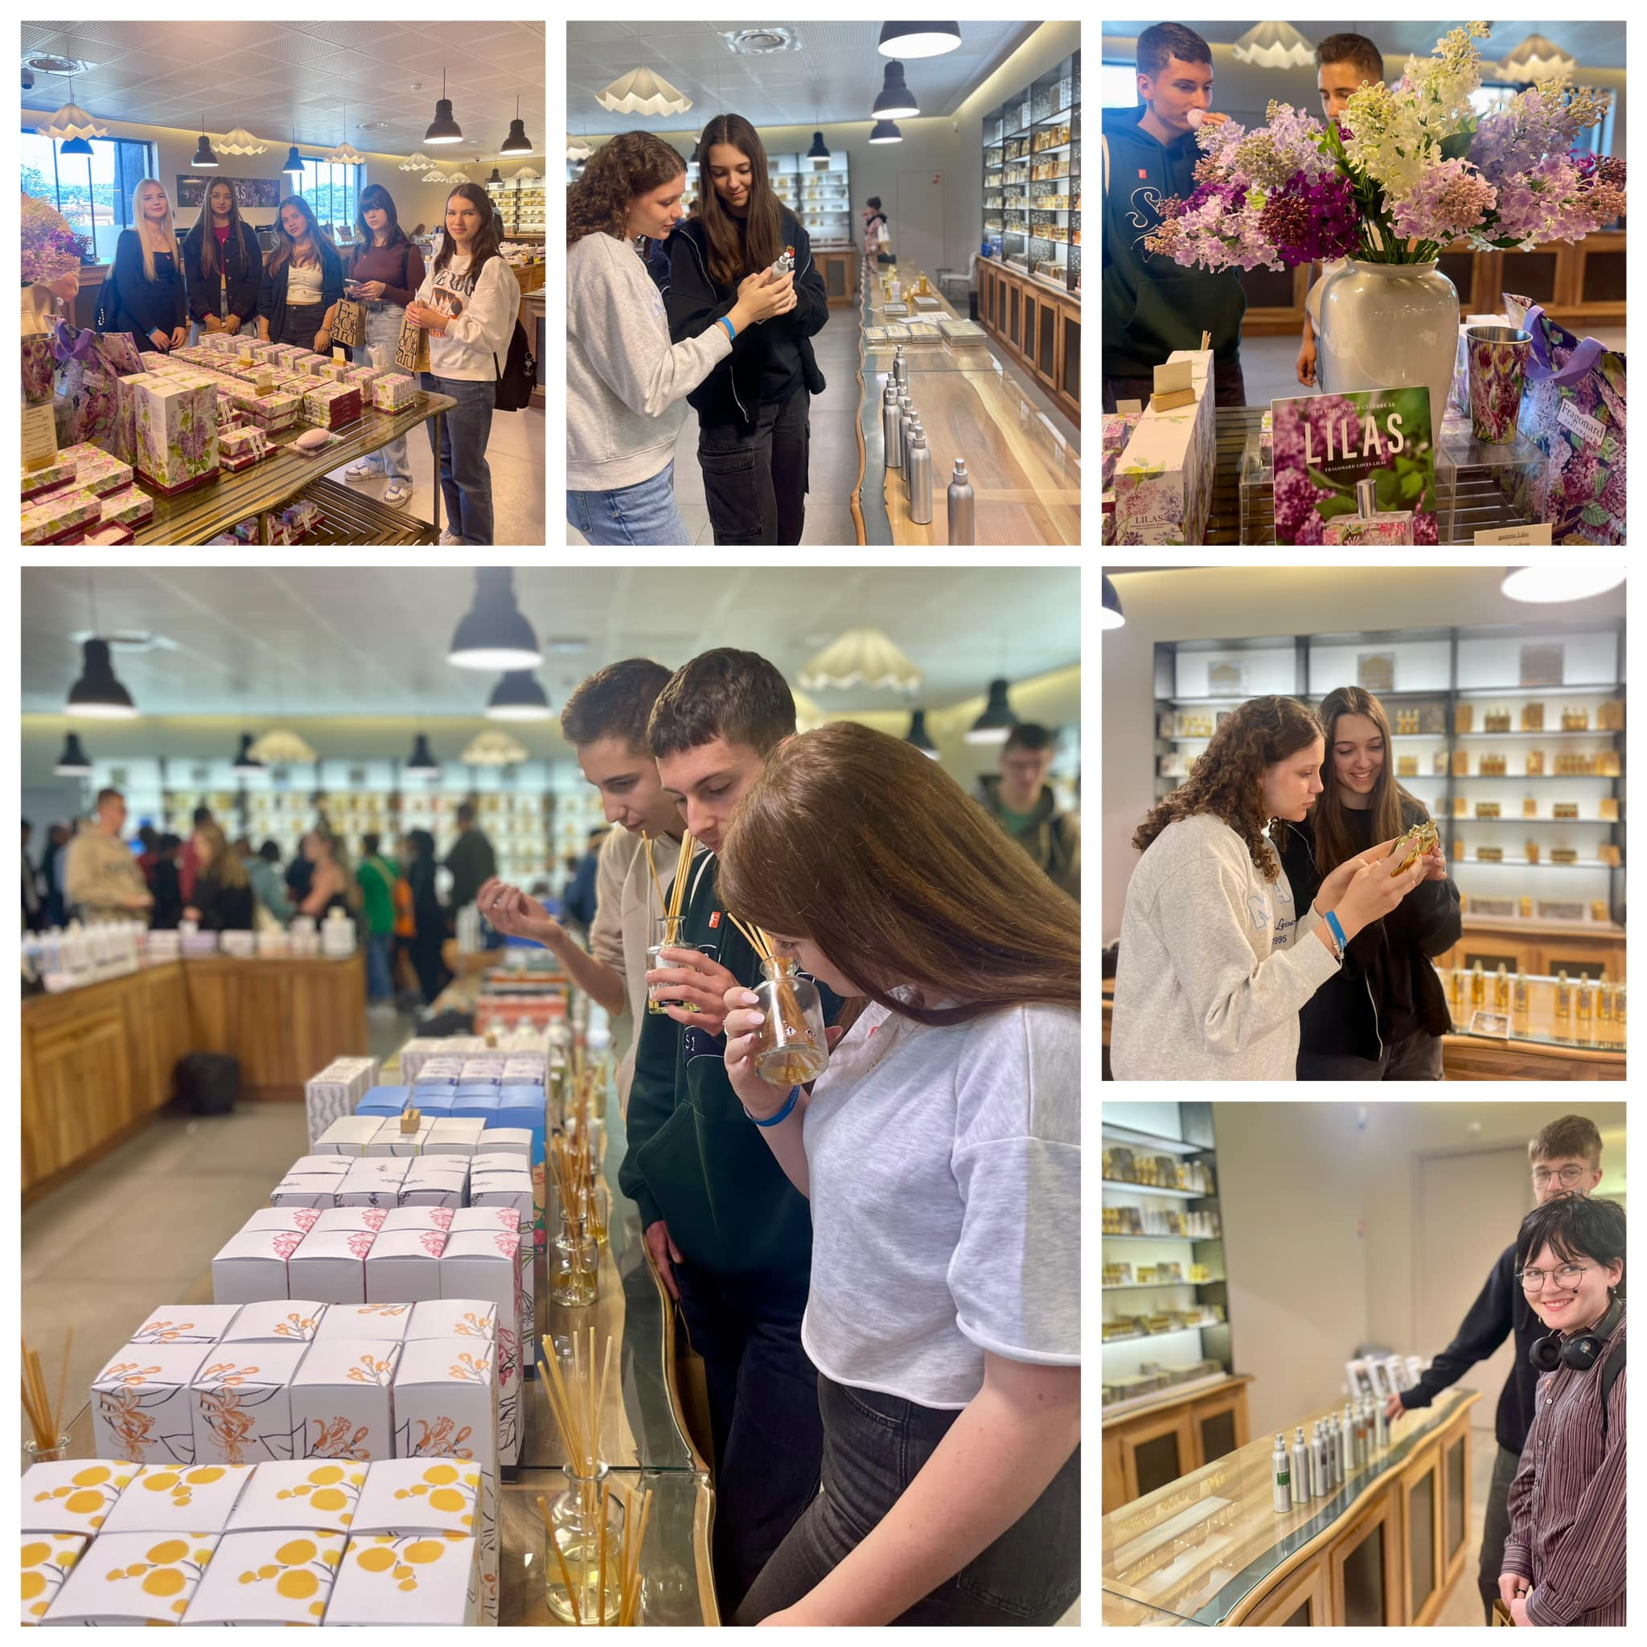
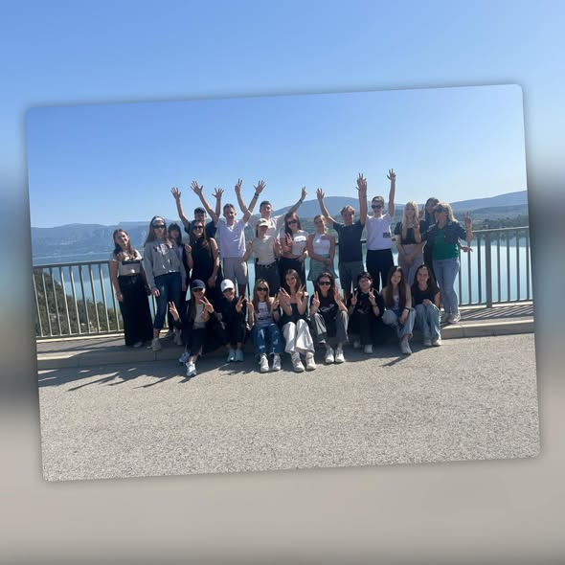
FRANCE 2024
Puget-sur-Argens
Saint – Tropez
Verdon canyon

Slide 8

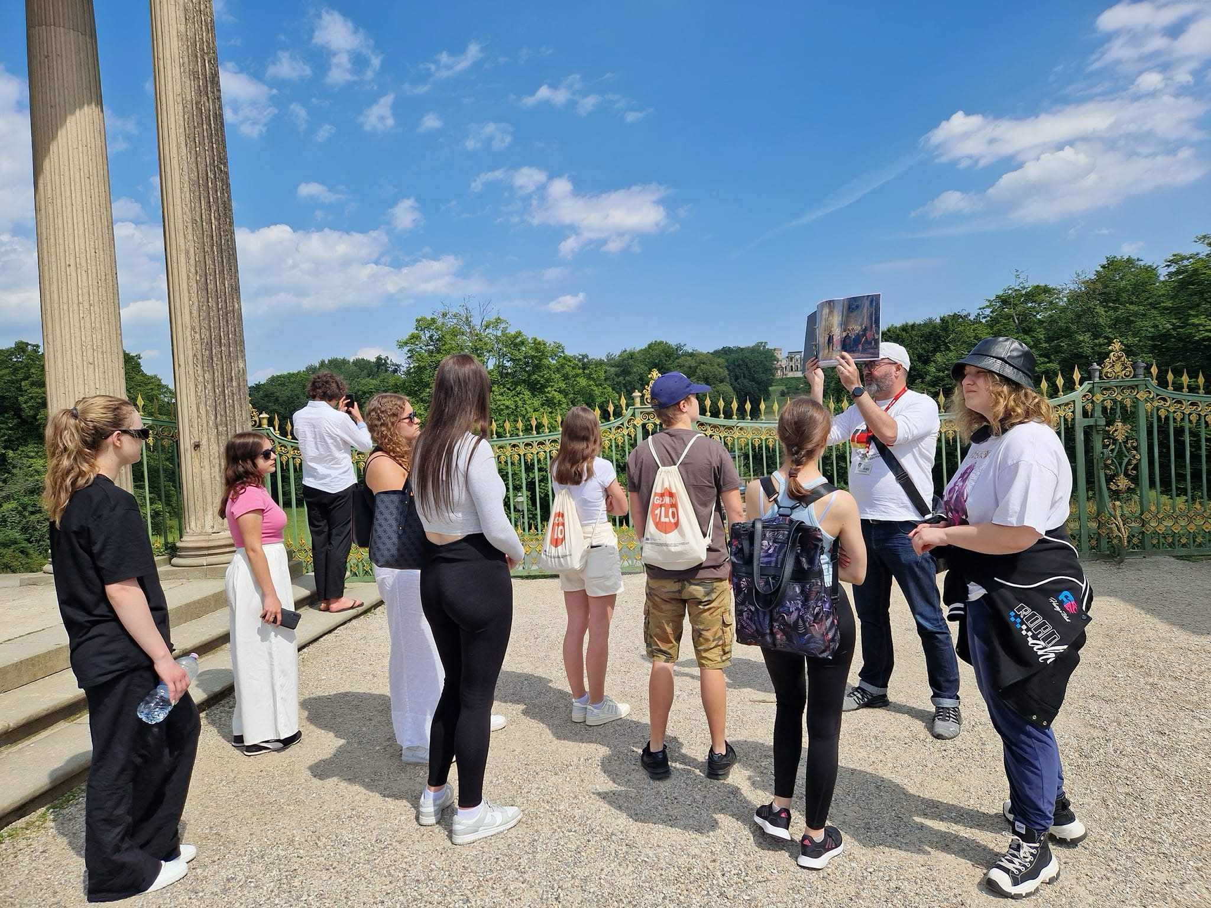
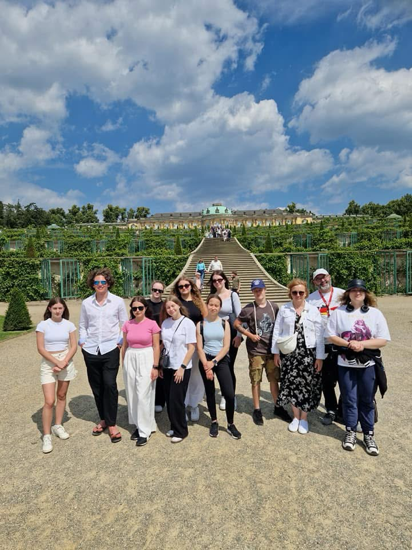
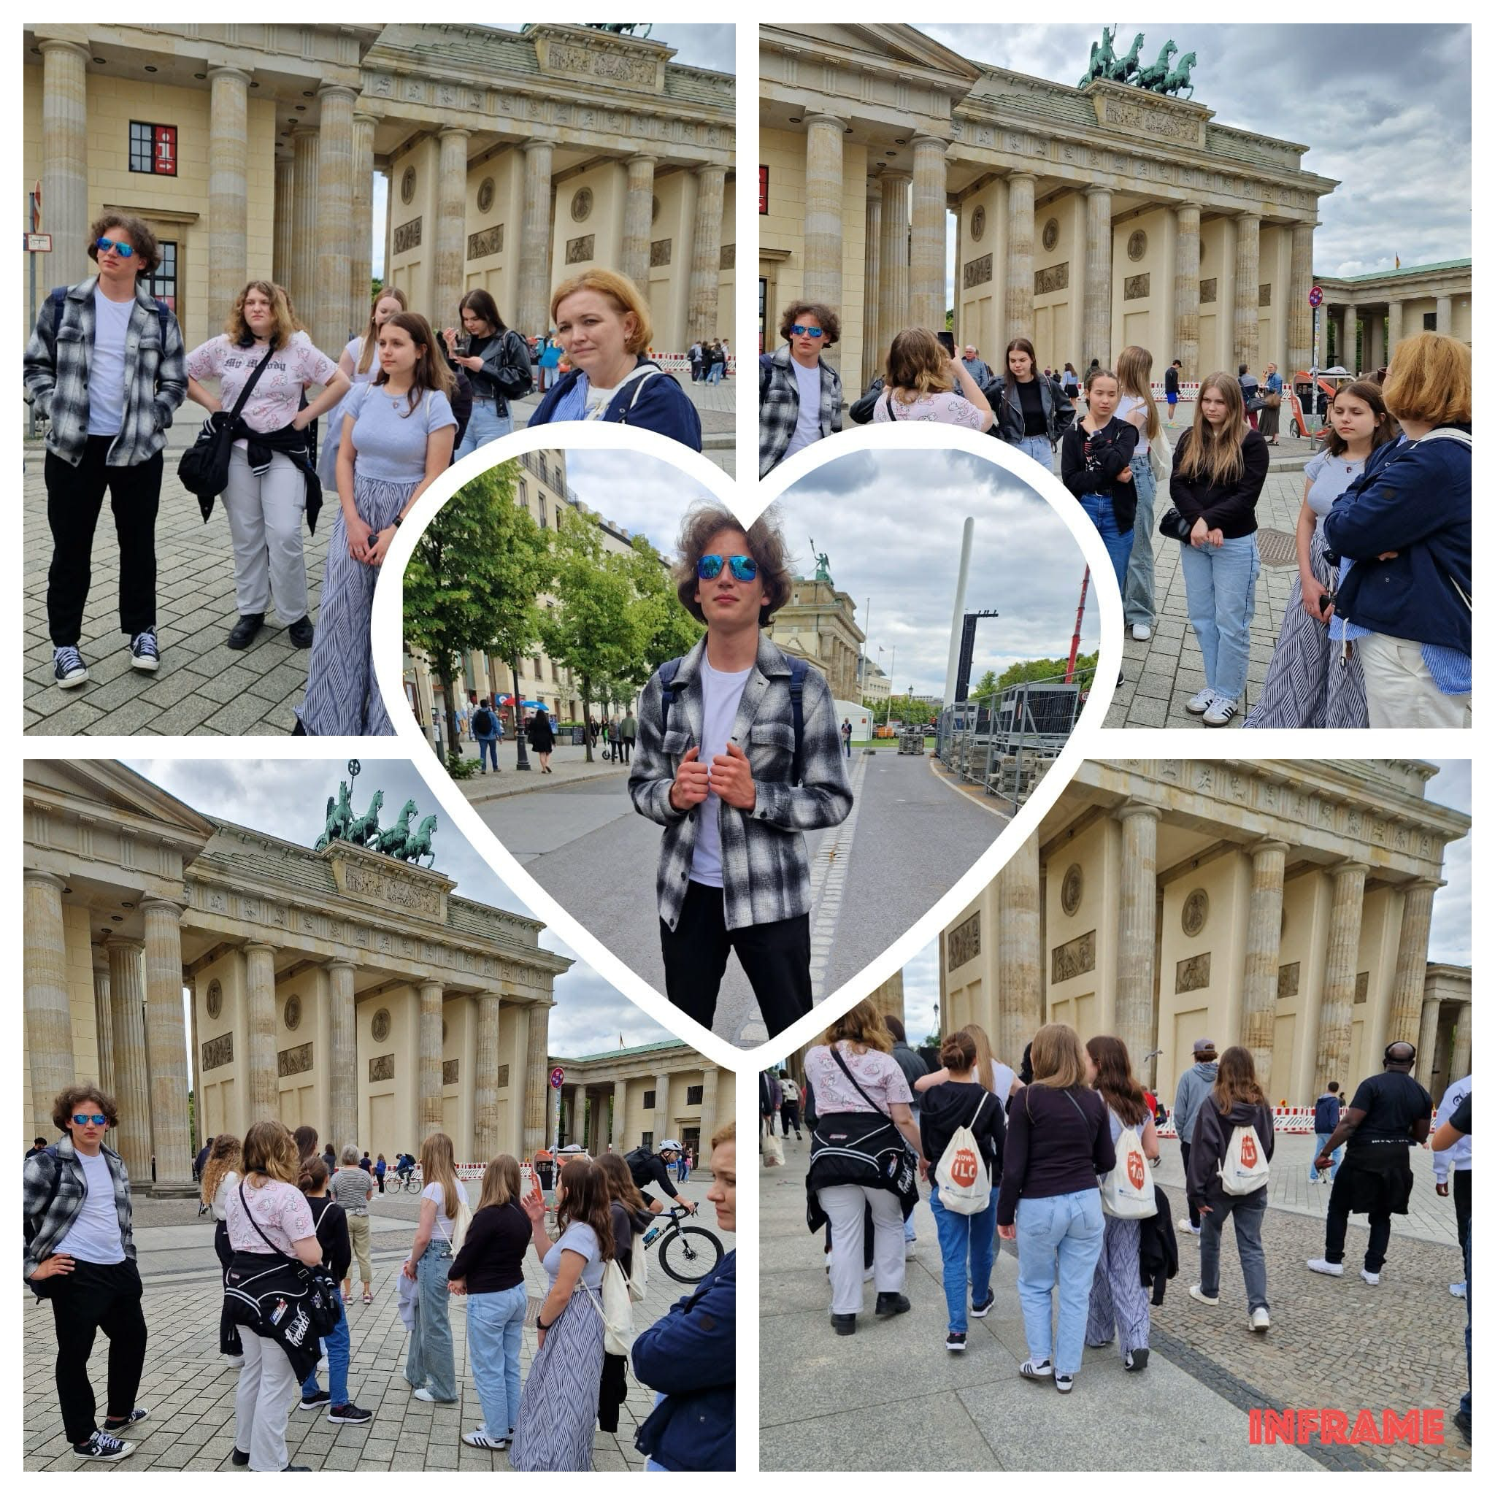
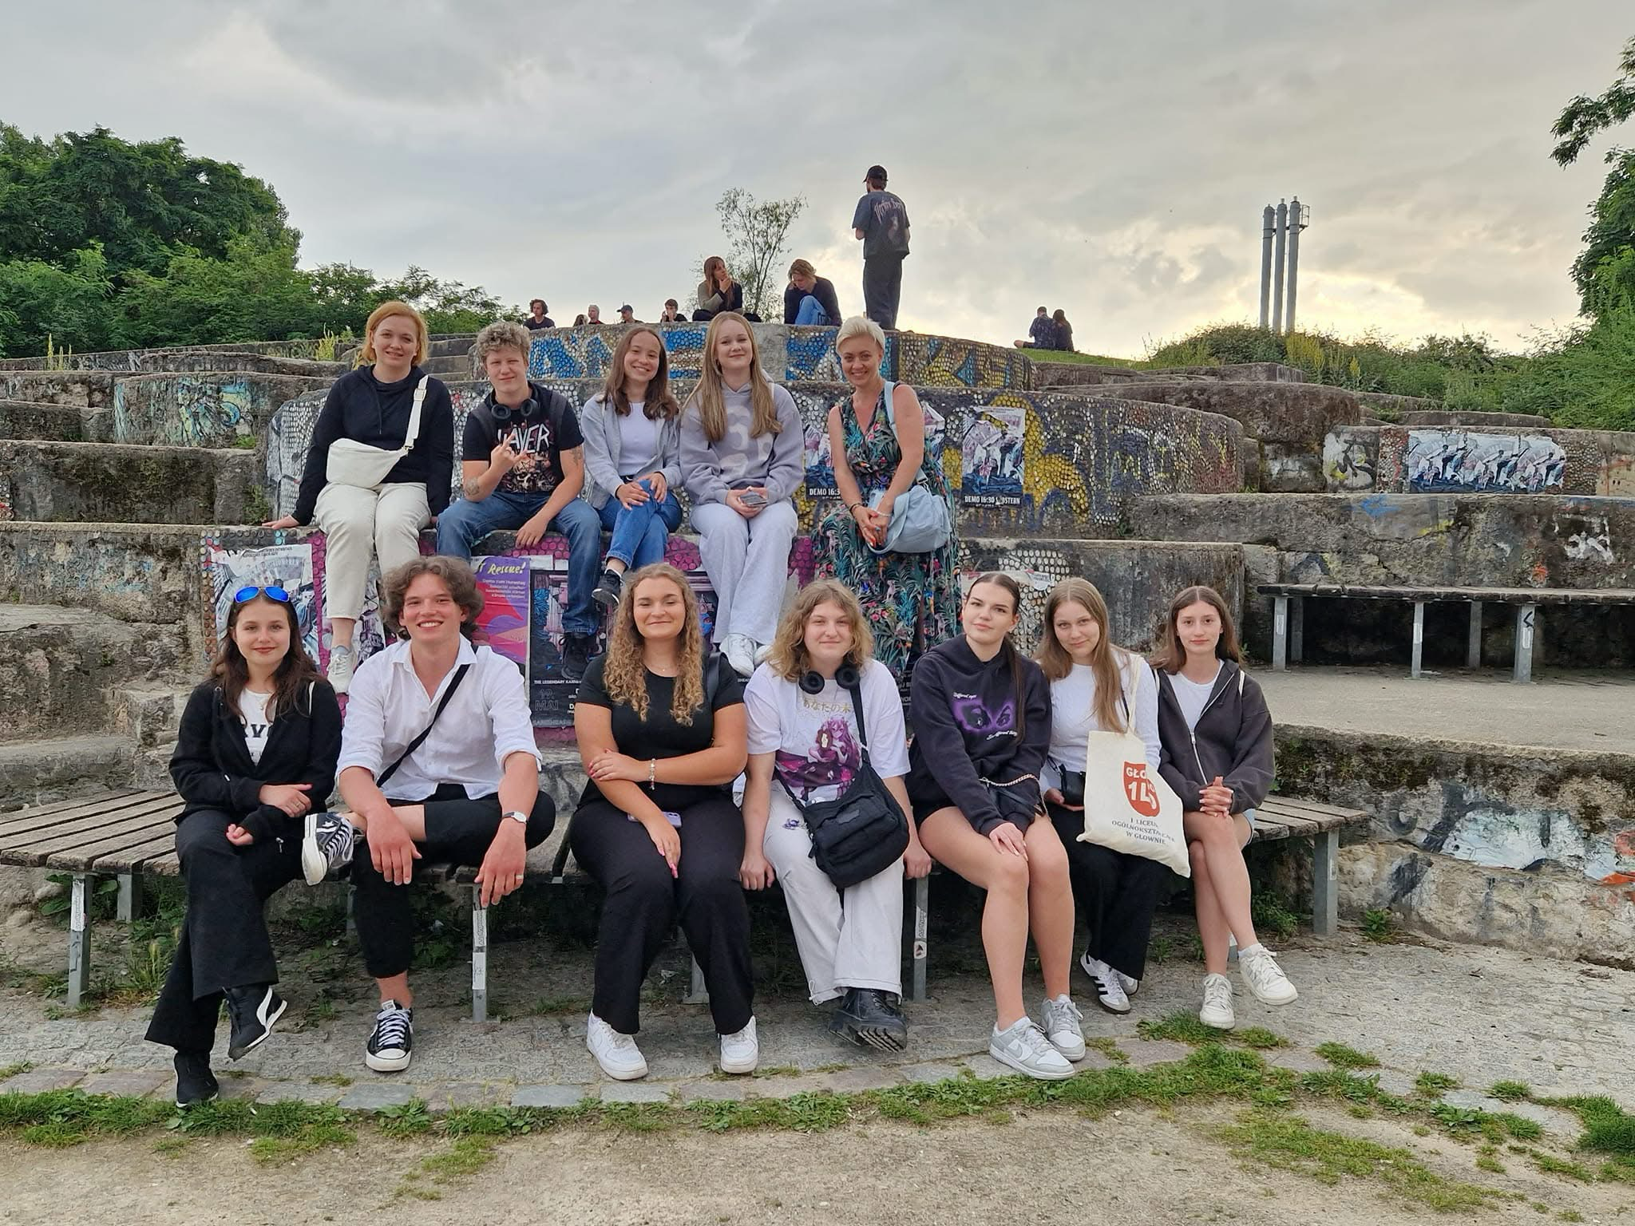
GERMANY 2023/24
BERLIN
- East Side Gallery
- Schloss Sanssucci
- Cacilienhof palace
I

Slide 9

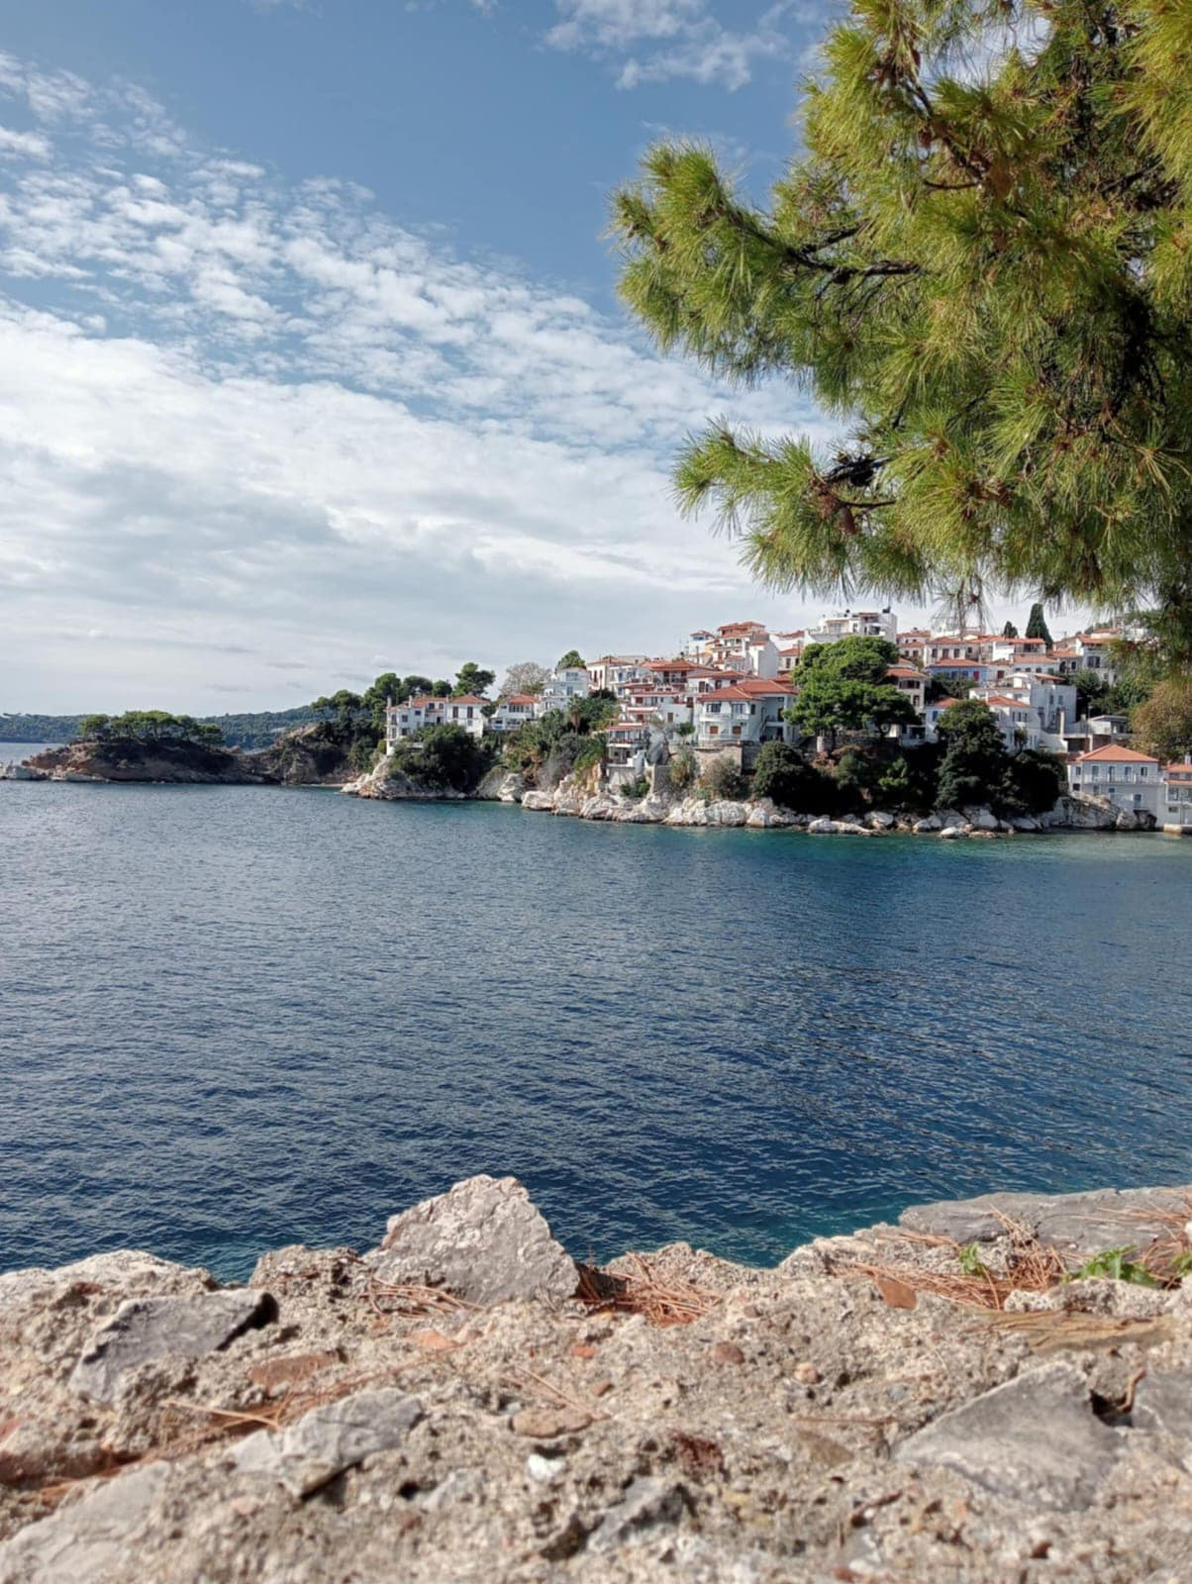
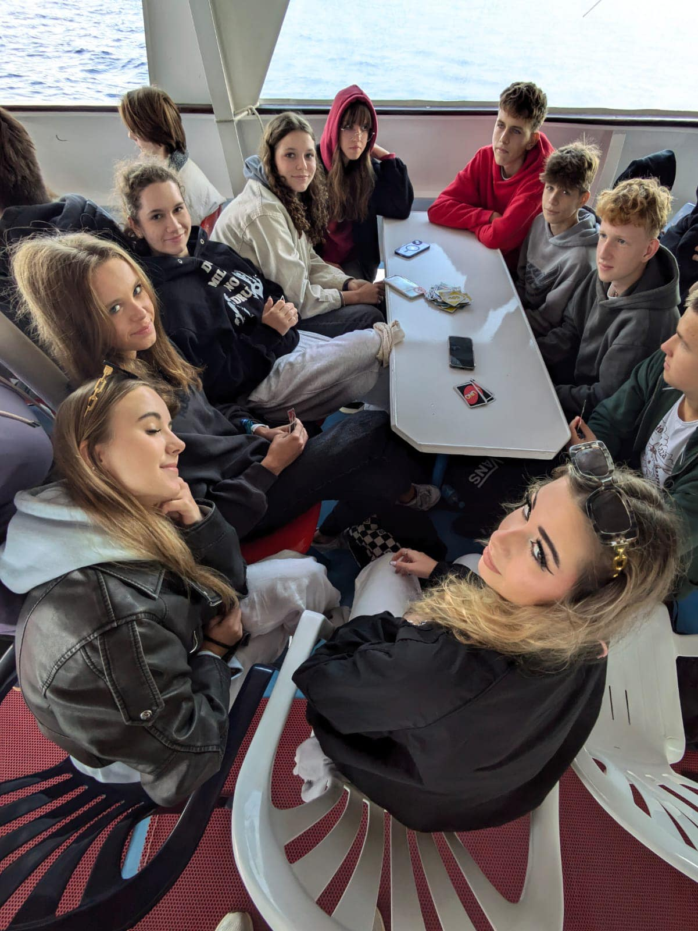
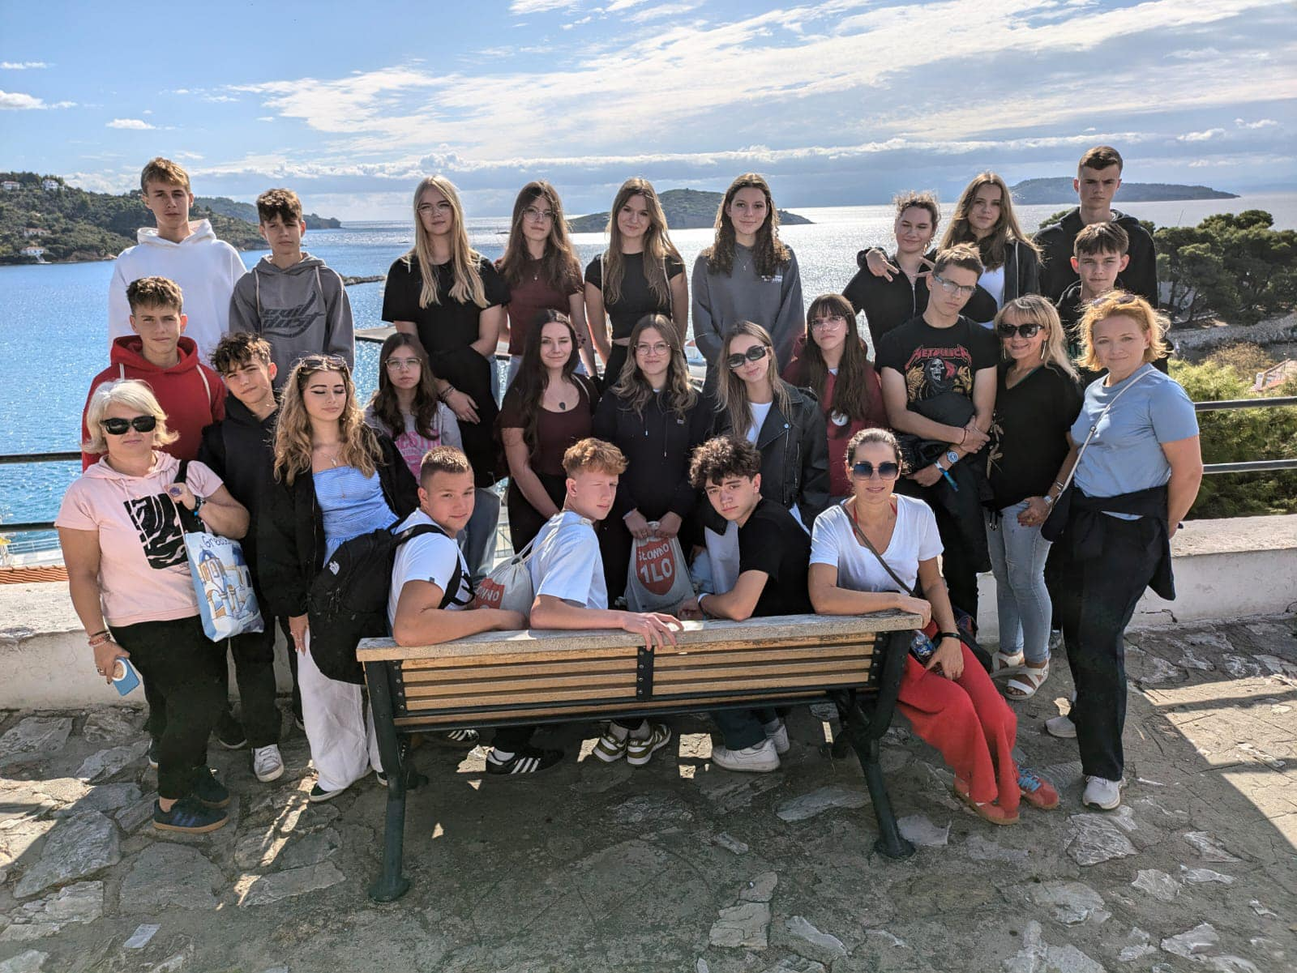
GRECE 2024
Platamonas
Skiathos island
Litochoro
Leptokarya
Olympus Information Center

Slide 10

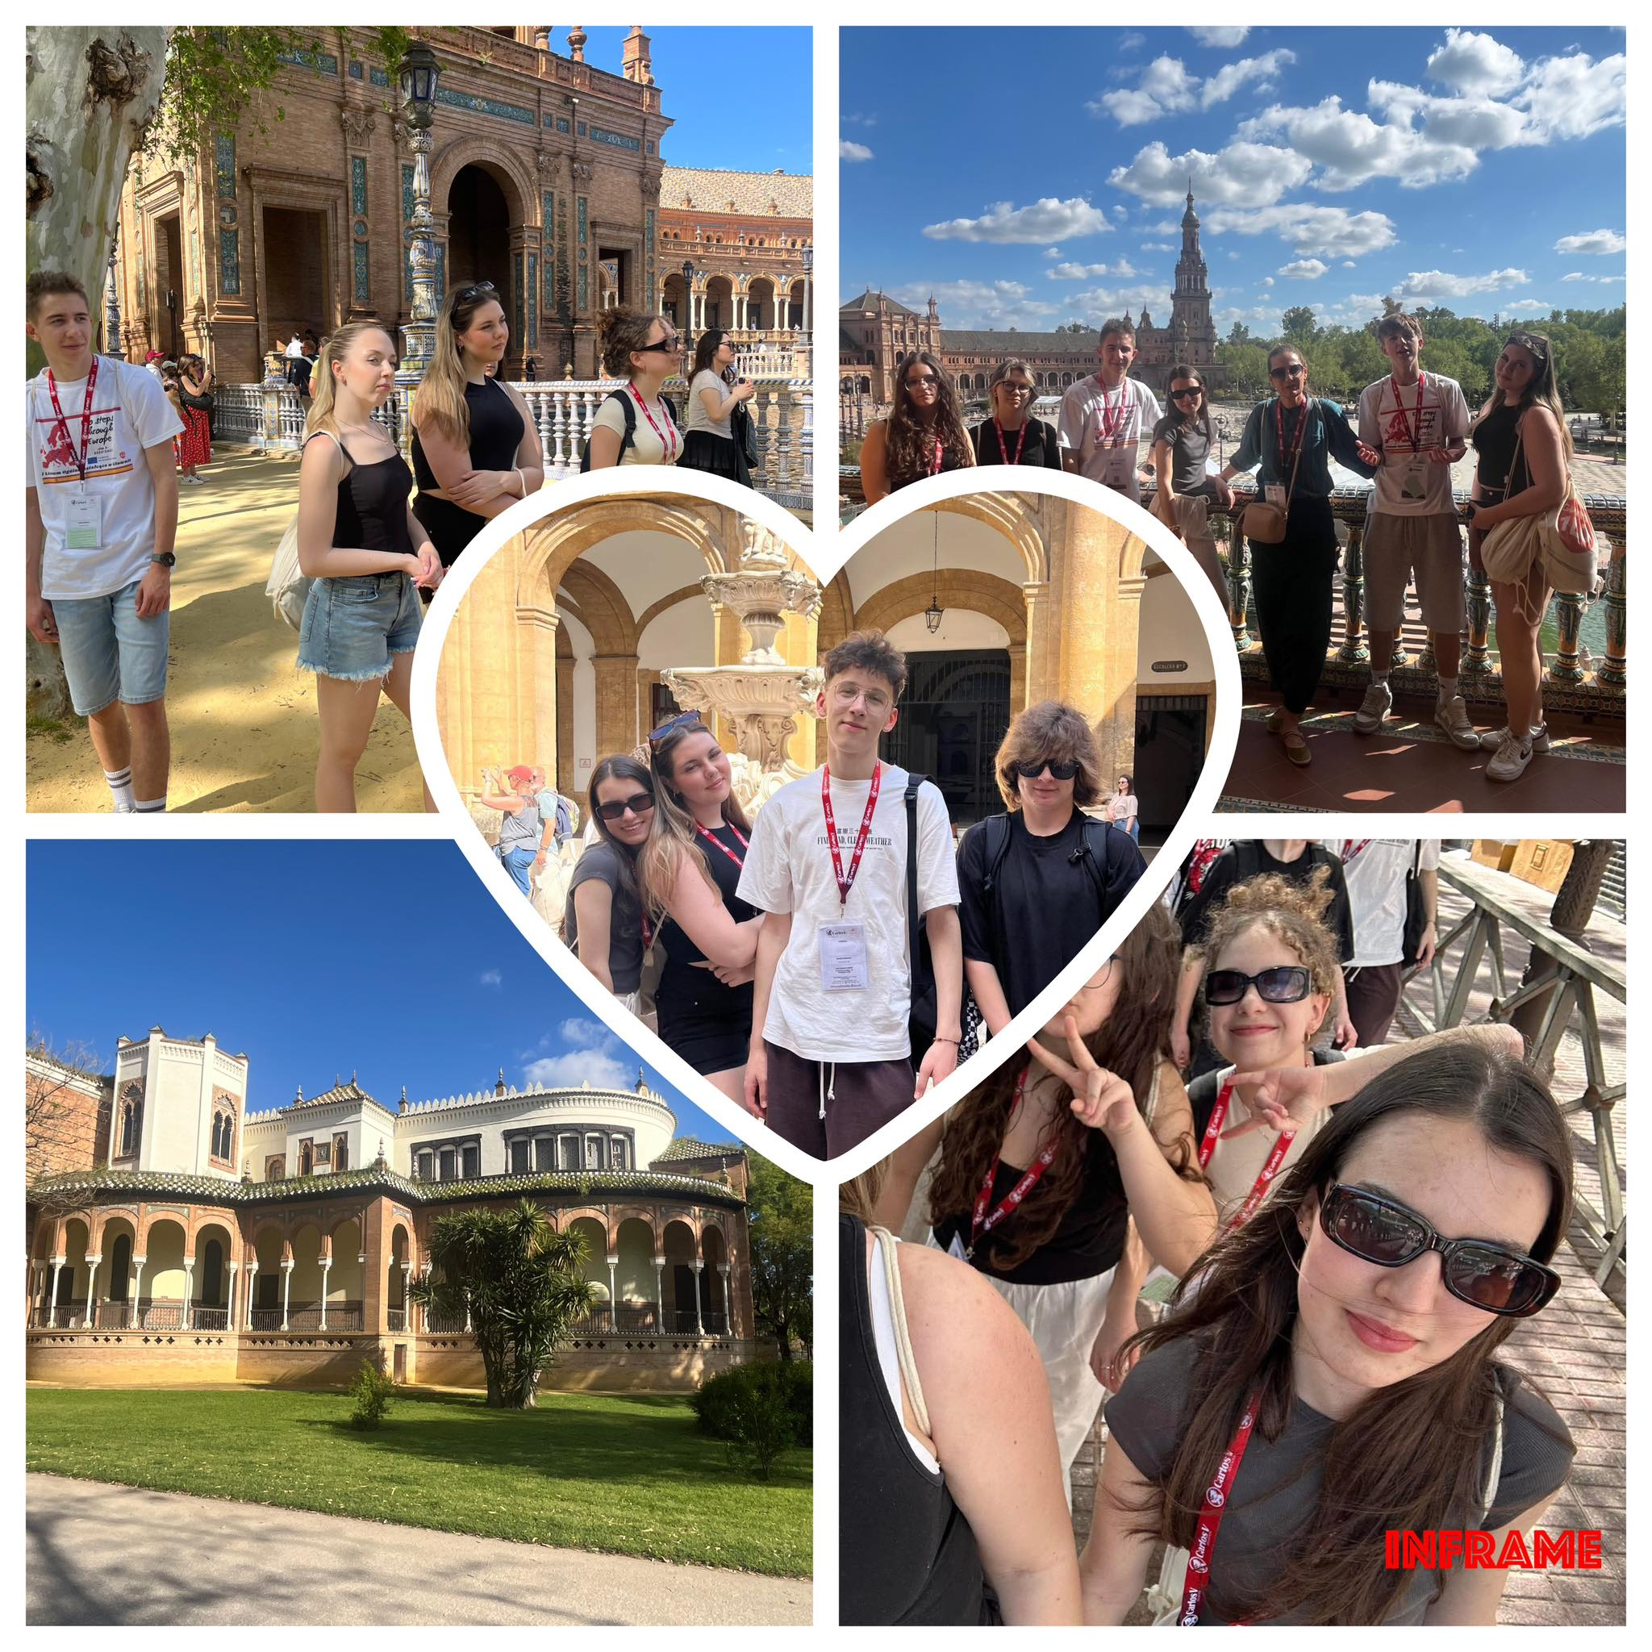
SPAIN 2025
Sevilla
Alcazar
Las Setas

Slide 11
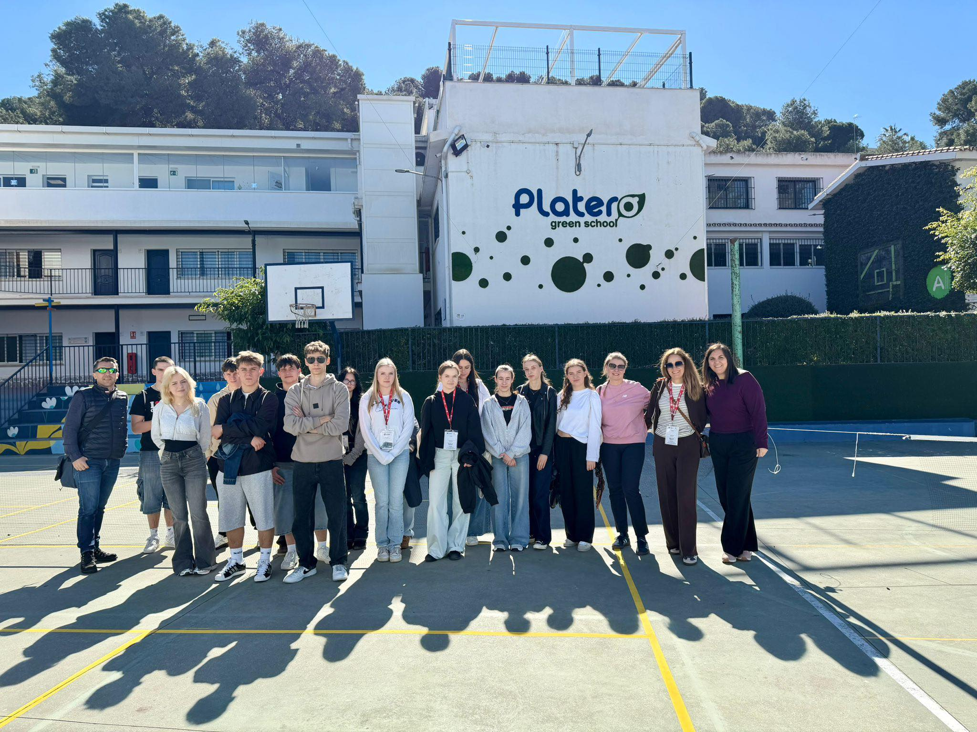
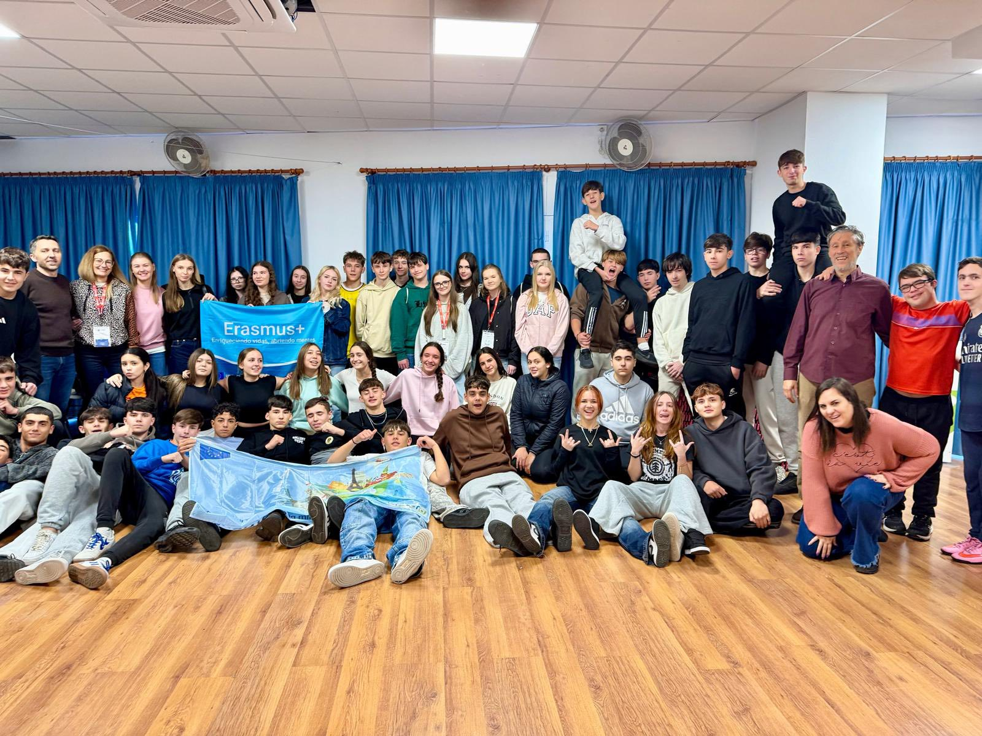
SPAIN 2026
Malaga

Slide 12
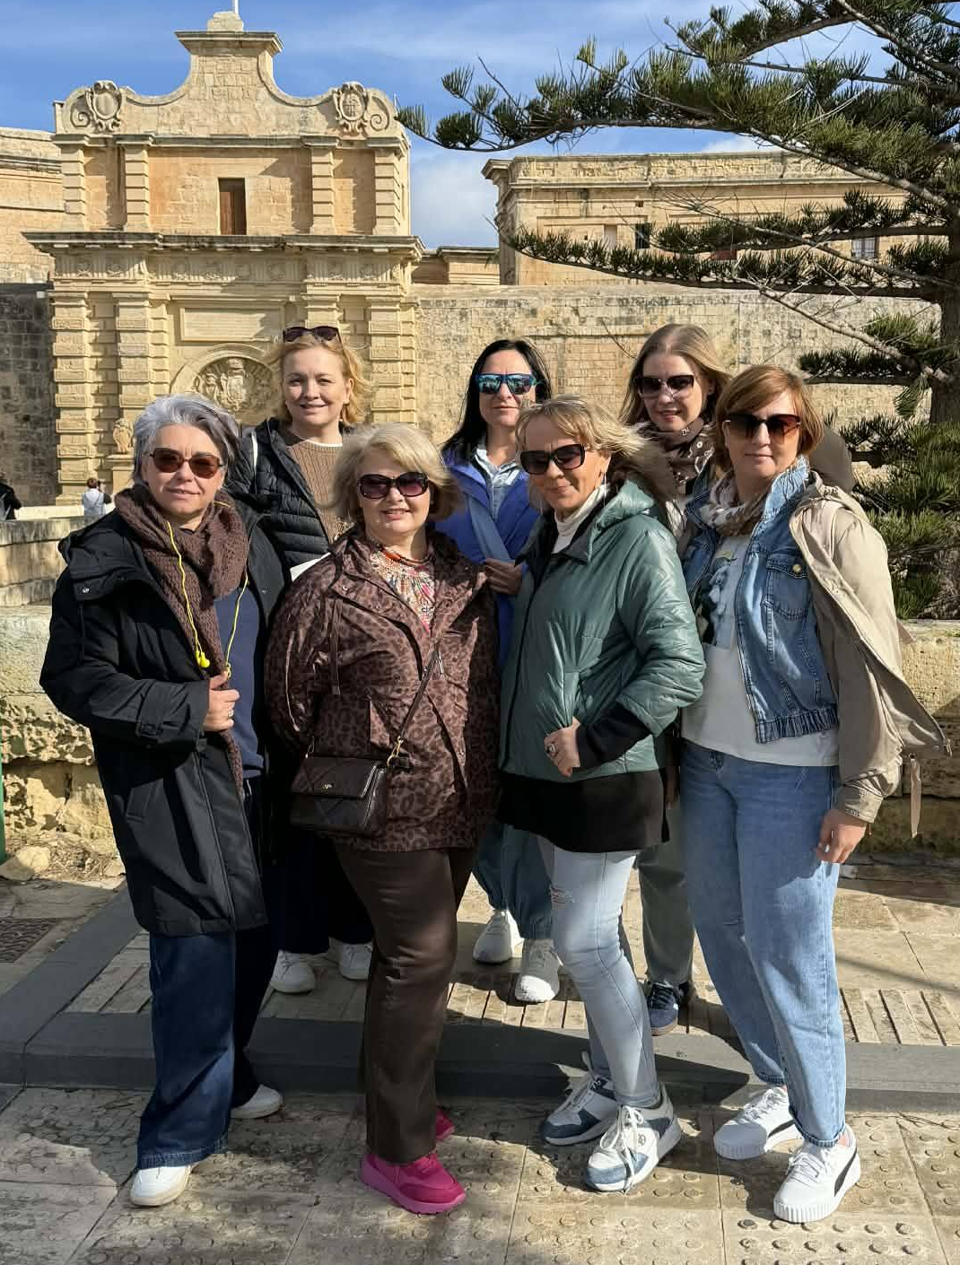
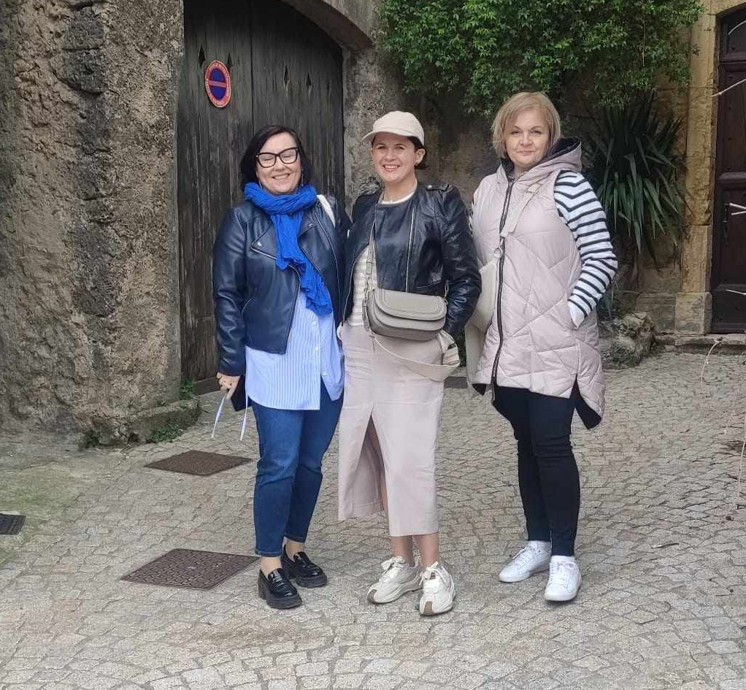
Teacher Courses

Slide 13
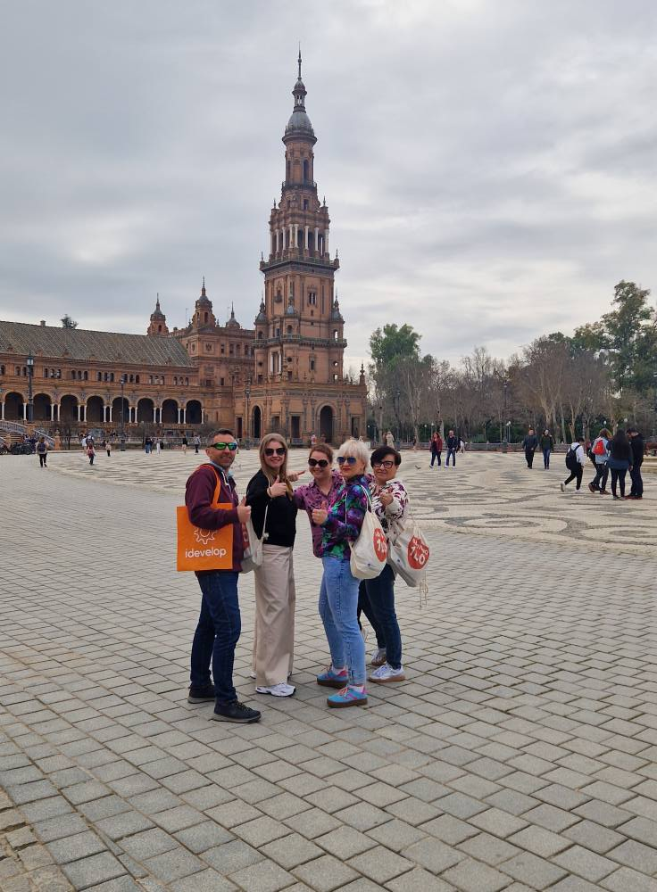
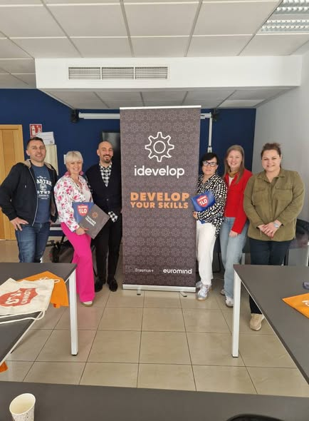
SPAIN 2025
Sevilla
"CLIL for success" course

Slide 14

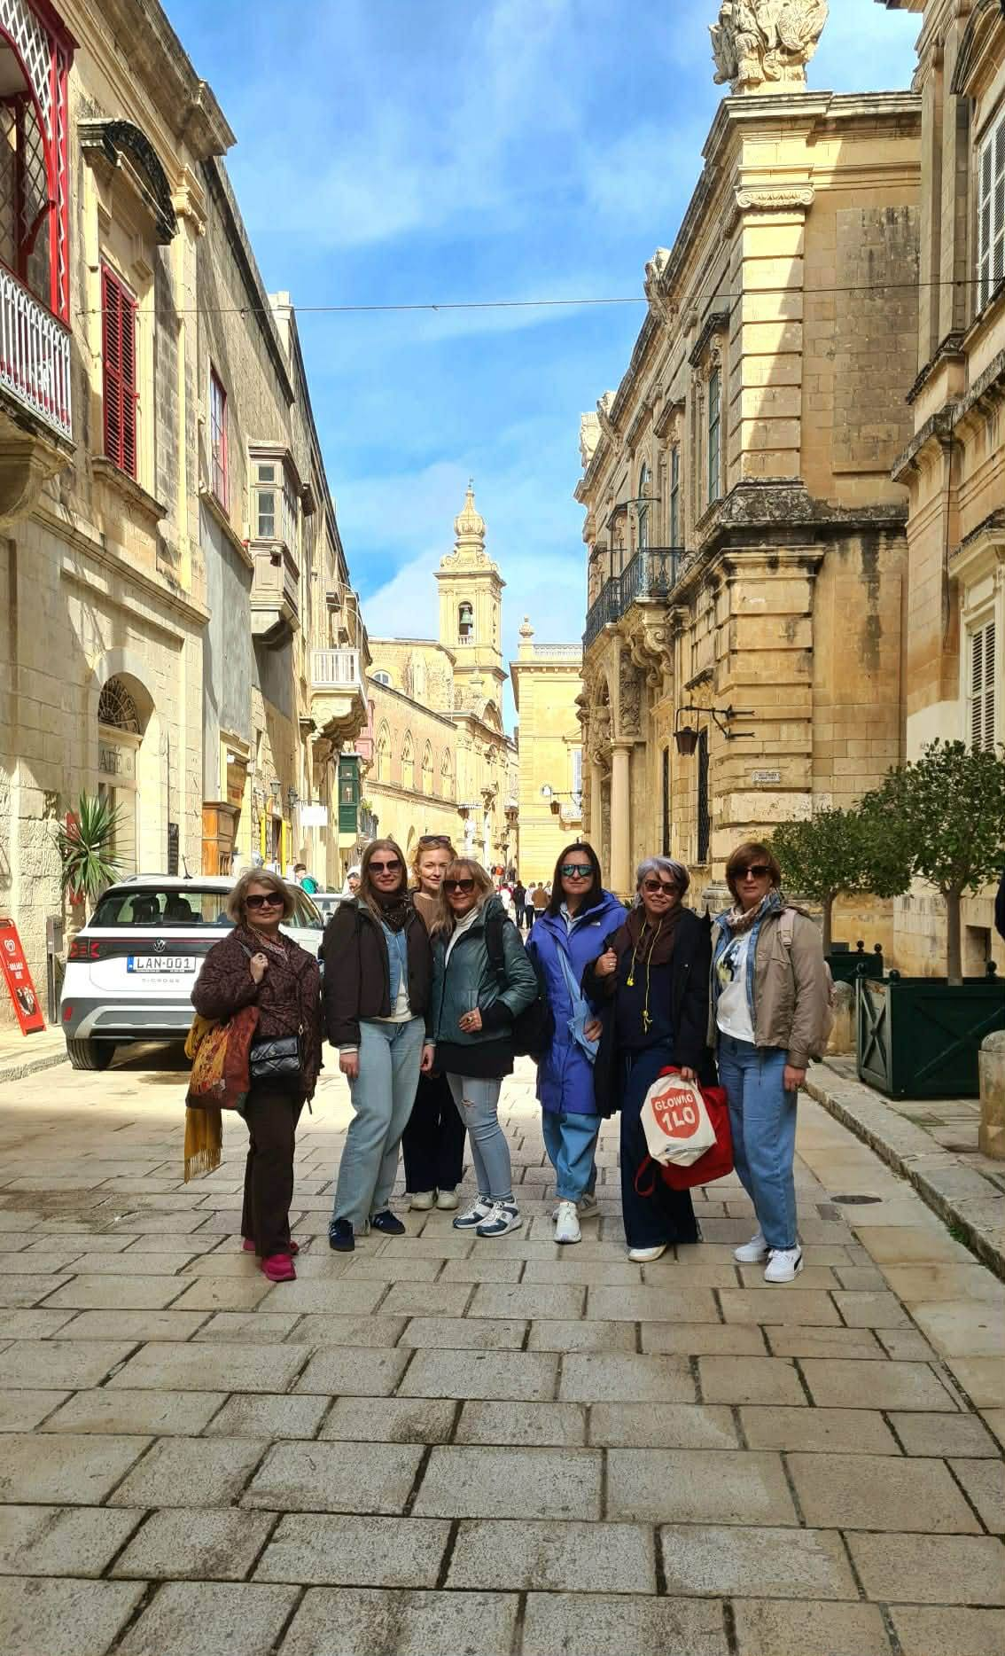
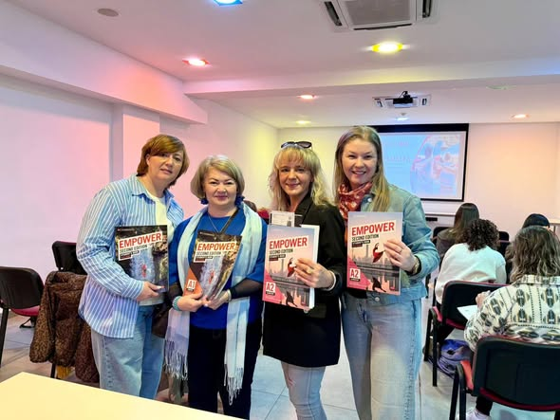
MALTA 2026

Slide 15
Gracias por su atención!!

